Slide 1
Year 3

Slide 2
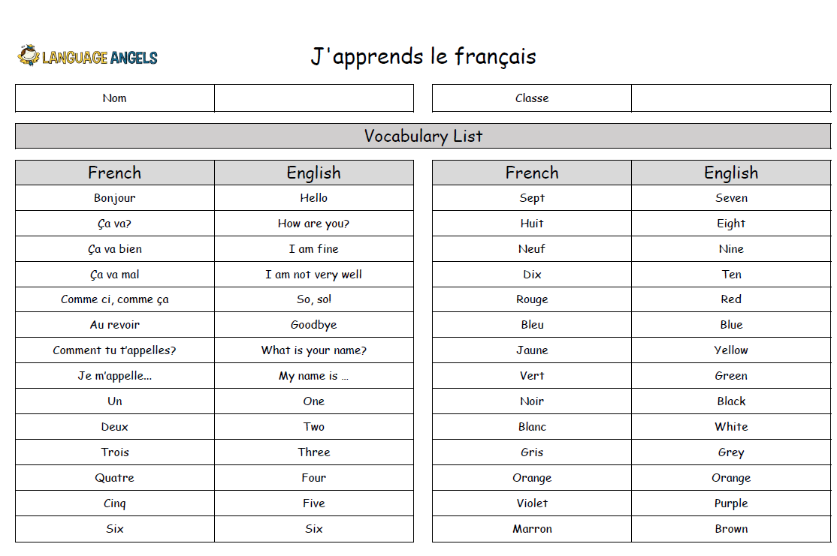
Y3 Autumn 1

Slide 3
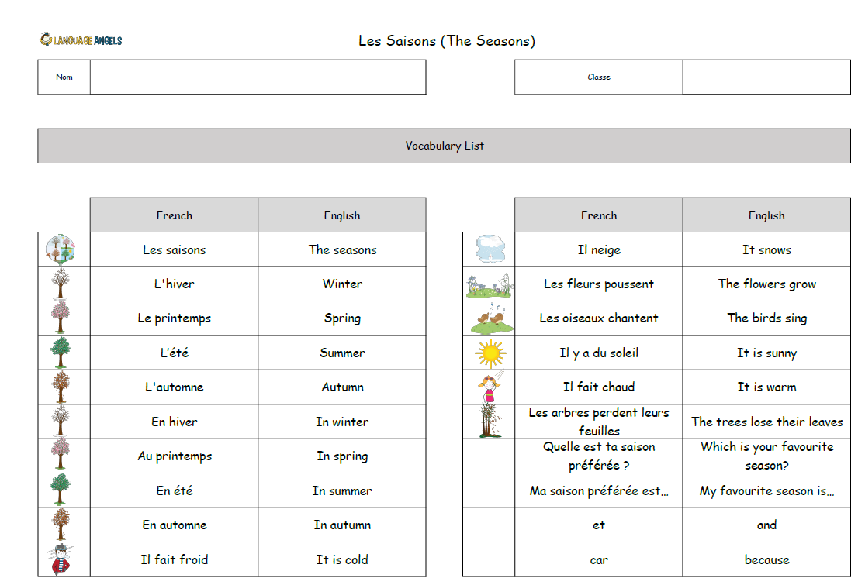
Y3 Autumn 2

Slide 4
Y3 Spring 1

Slide 5
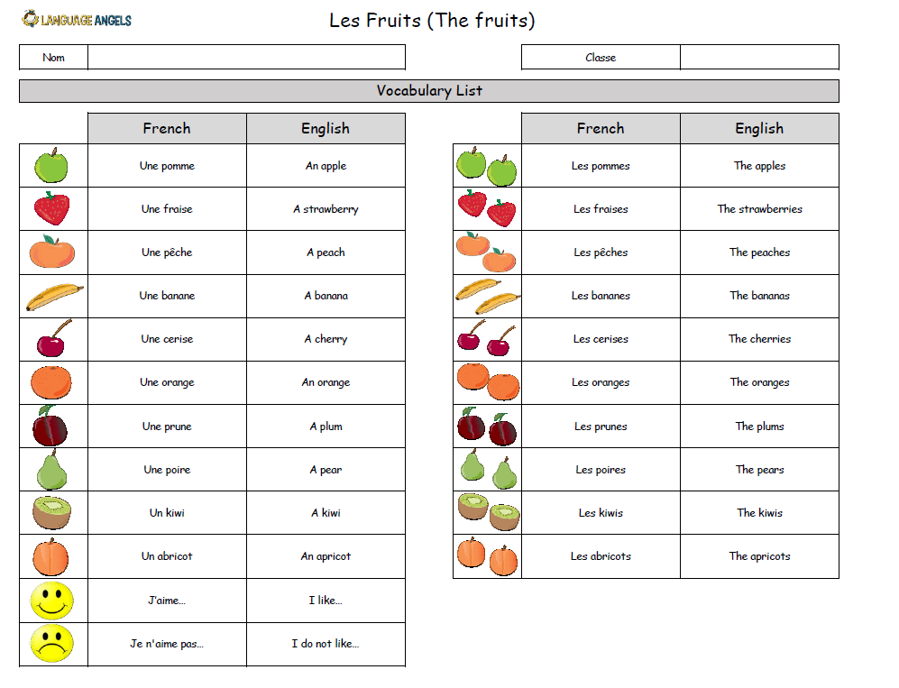
Y3 Spring 2

Slide 6
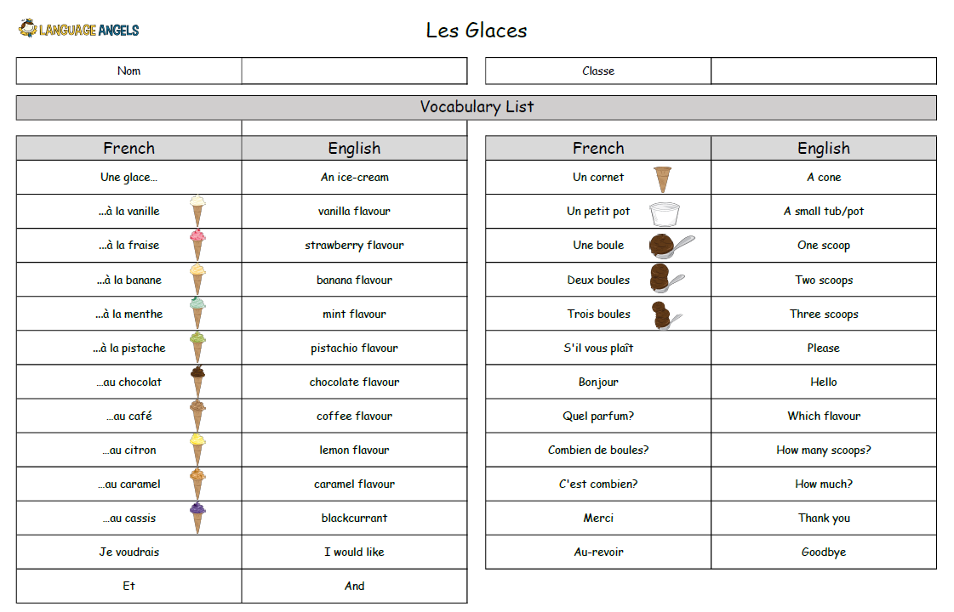
Y3 Y3 Summer 1

Slide 7
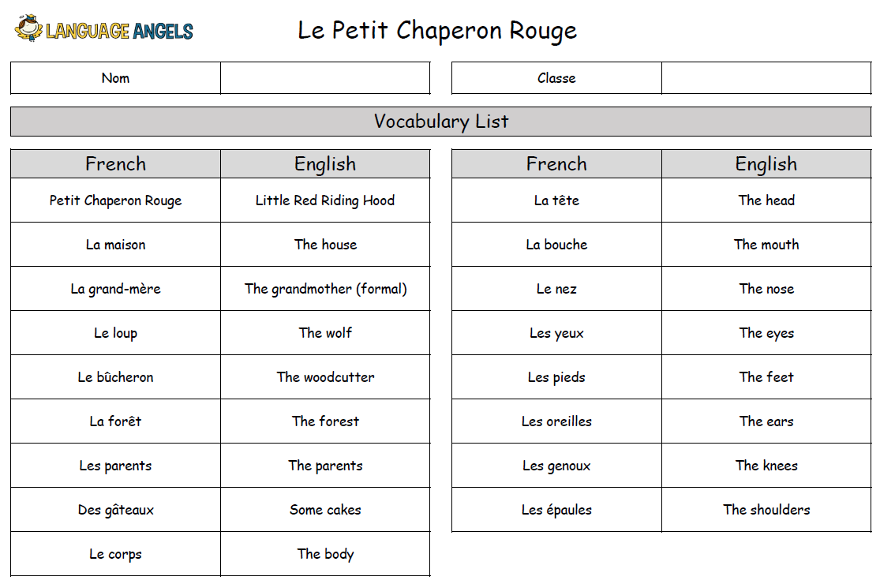
Y3 Summer 2

Slide 8
Year 4

Slide 9
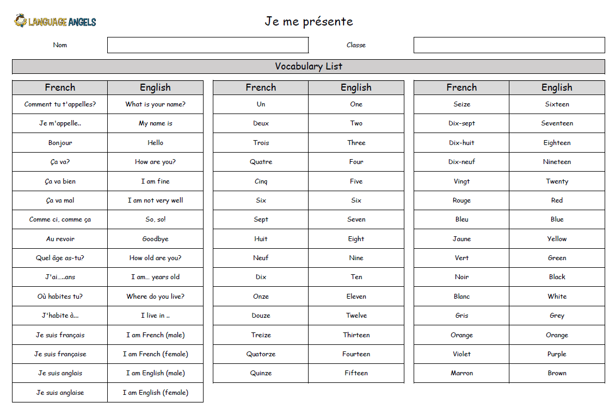
Y4 Autumn 1

Slide 10
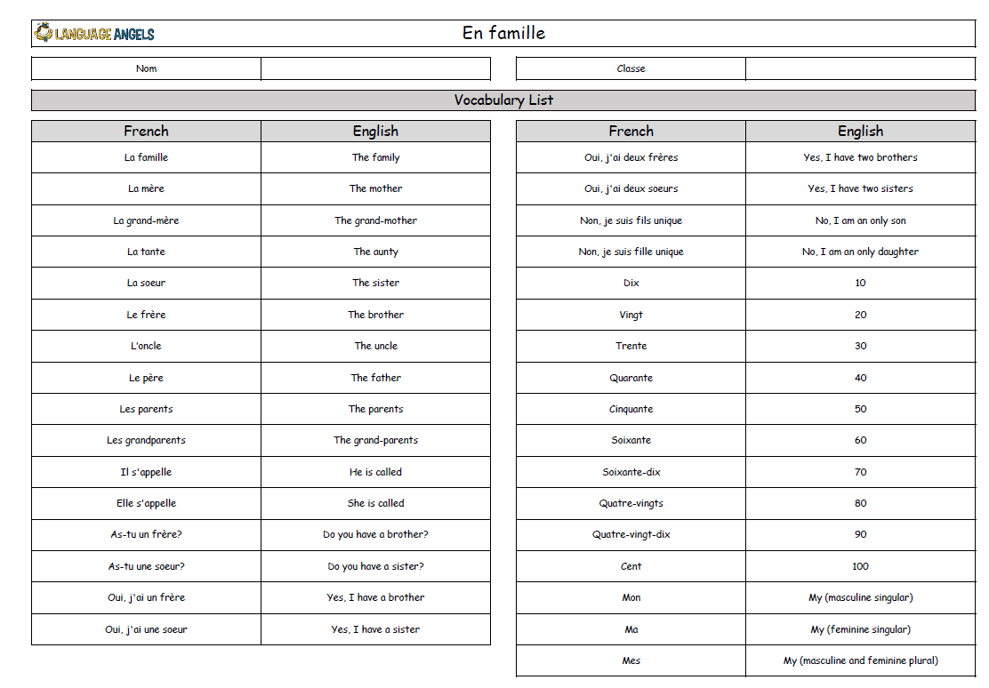
Y4 Autumn 2

Slide 11
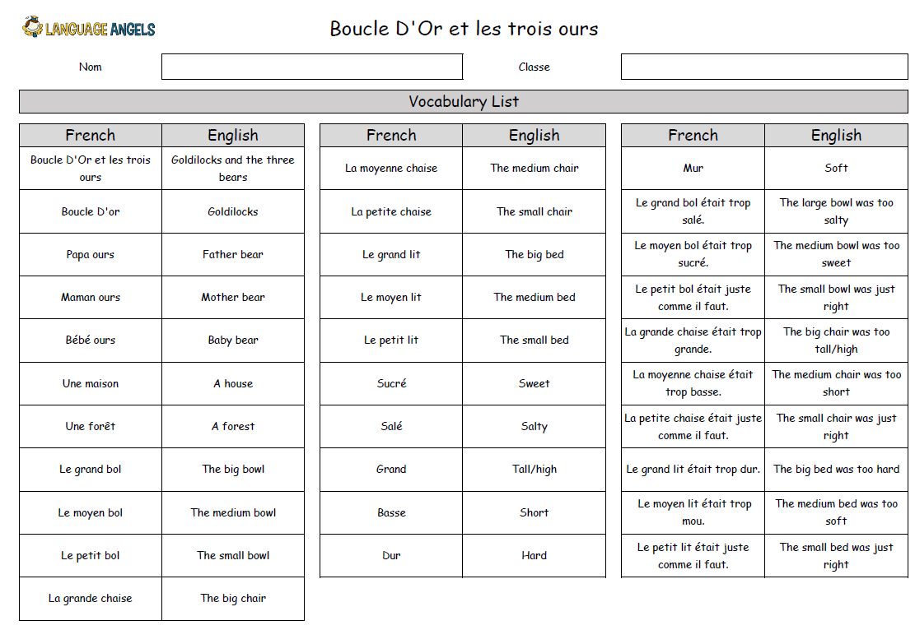
Y4 Spring 1

Slide 12
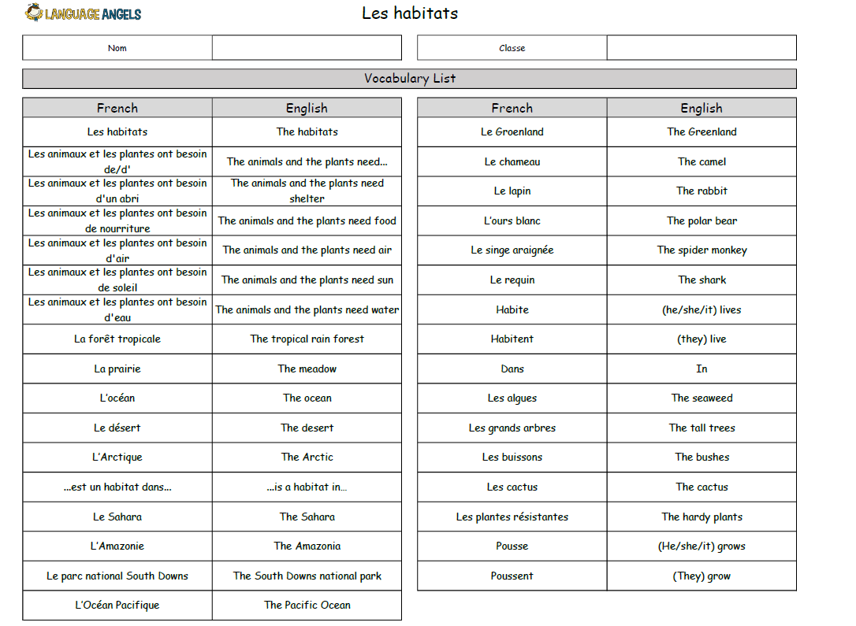
Y4 Spring 2

Slide 13
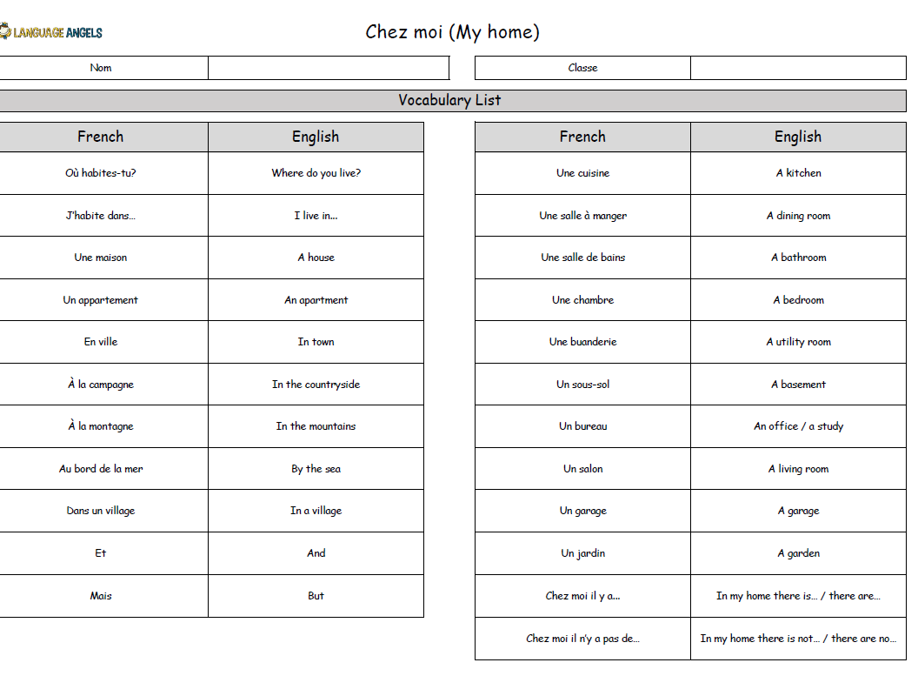
Y4 Summer 1

Slide 14
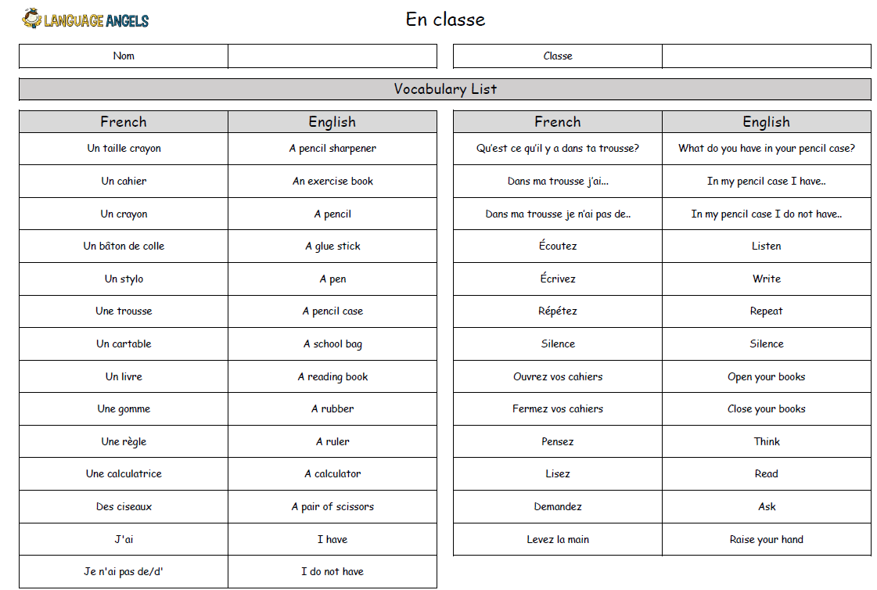
Y4 Summer 2

Slide 15
Year 5

Slide 16
Y5 Autumn 1

Slide 17
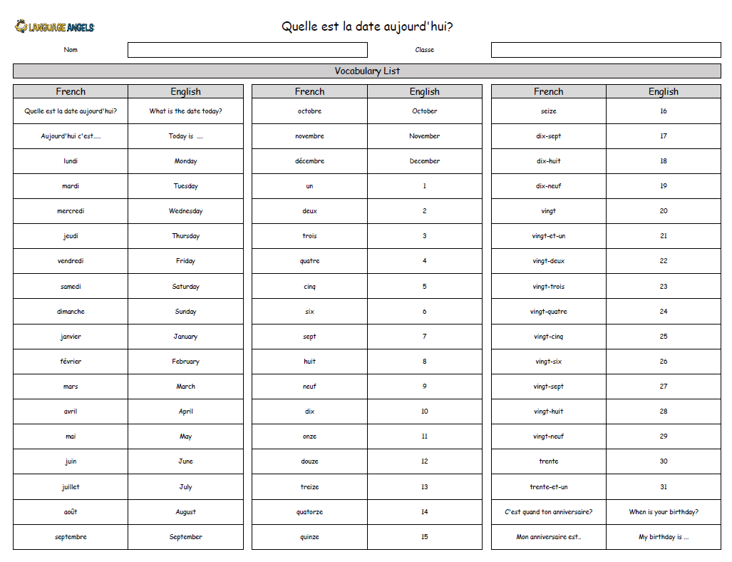
Y5 Autumn 2

Slide 18
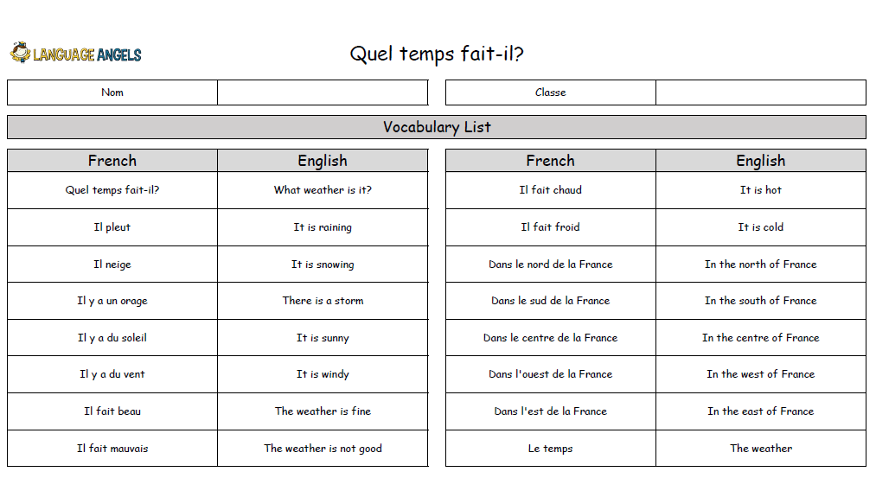
Y5 Spring 1

Slide 19
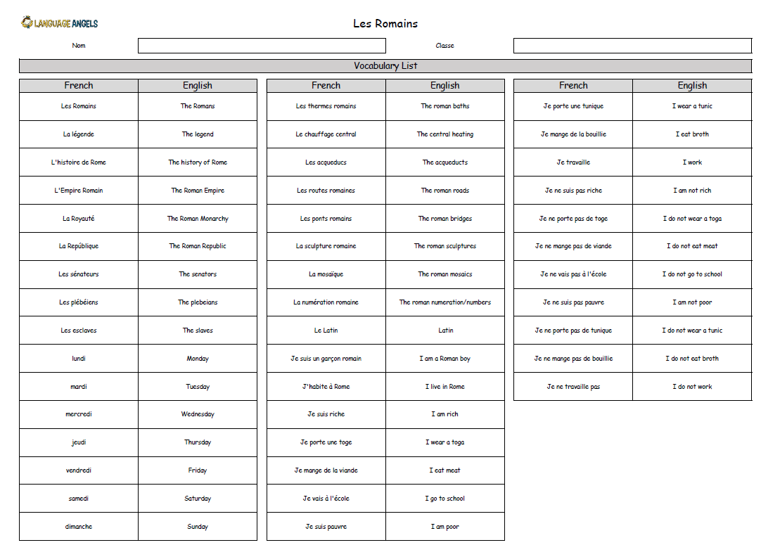
Y5 Spring 2

Slide 20
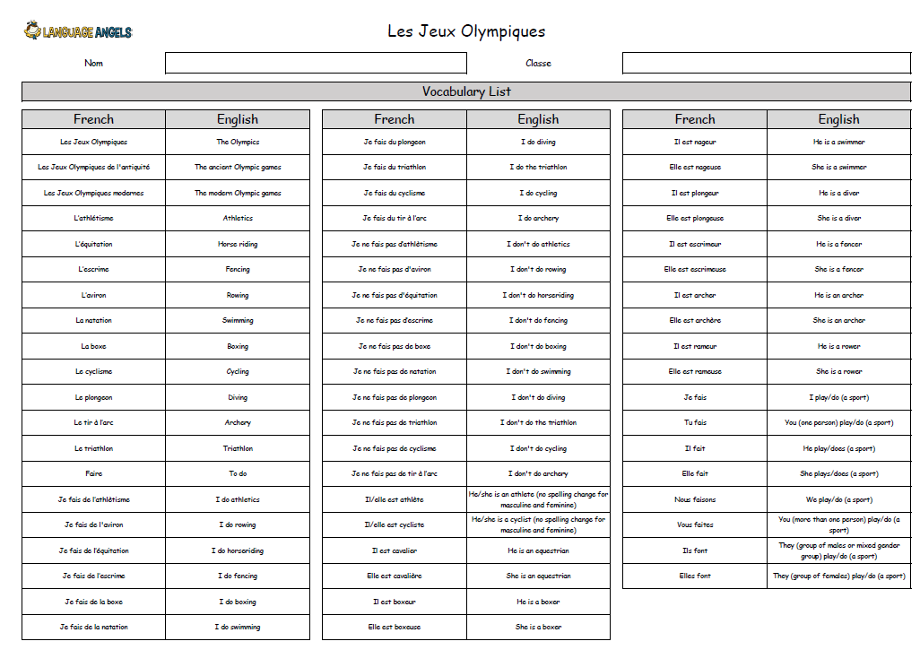
Y5 Summer 1

Slide 21
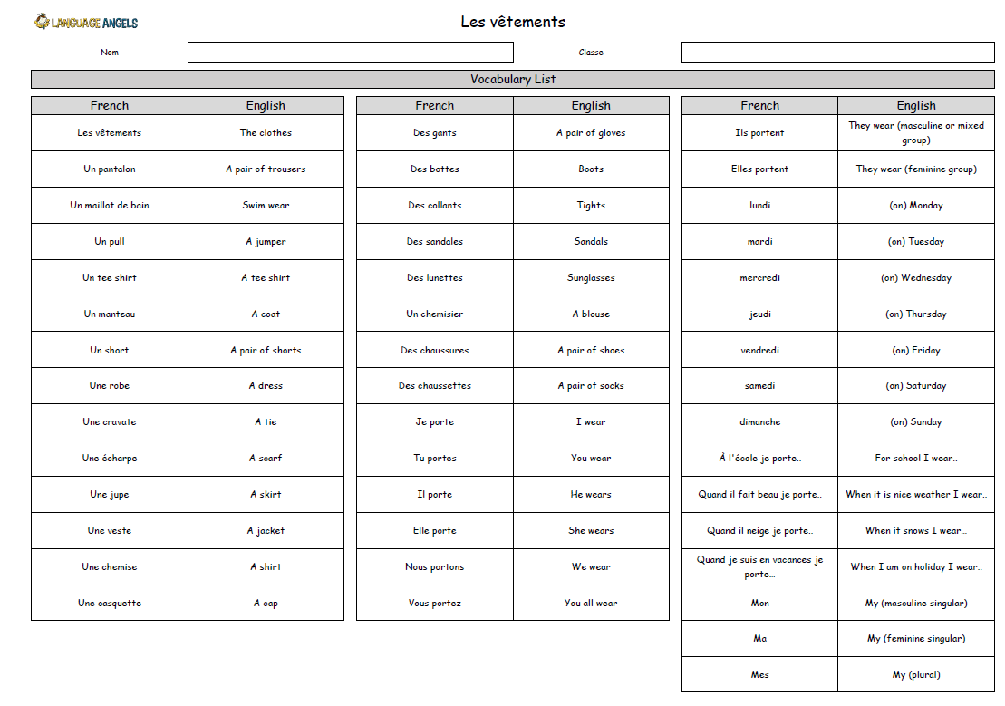
Y5 Summer 2

Slide 22
Year 6

Slide 23
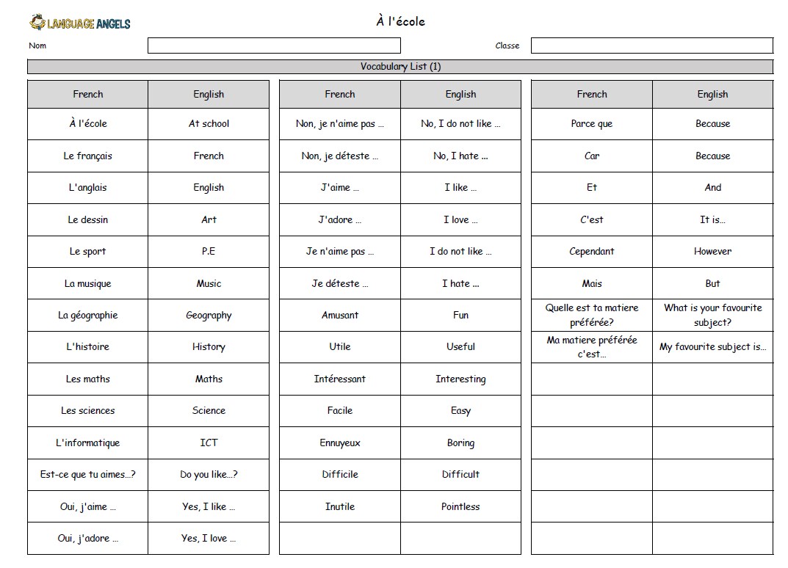
Y6 Autumn 1

Slide 24
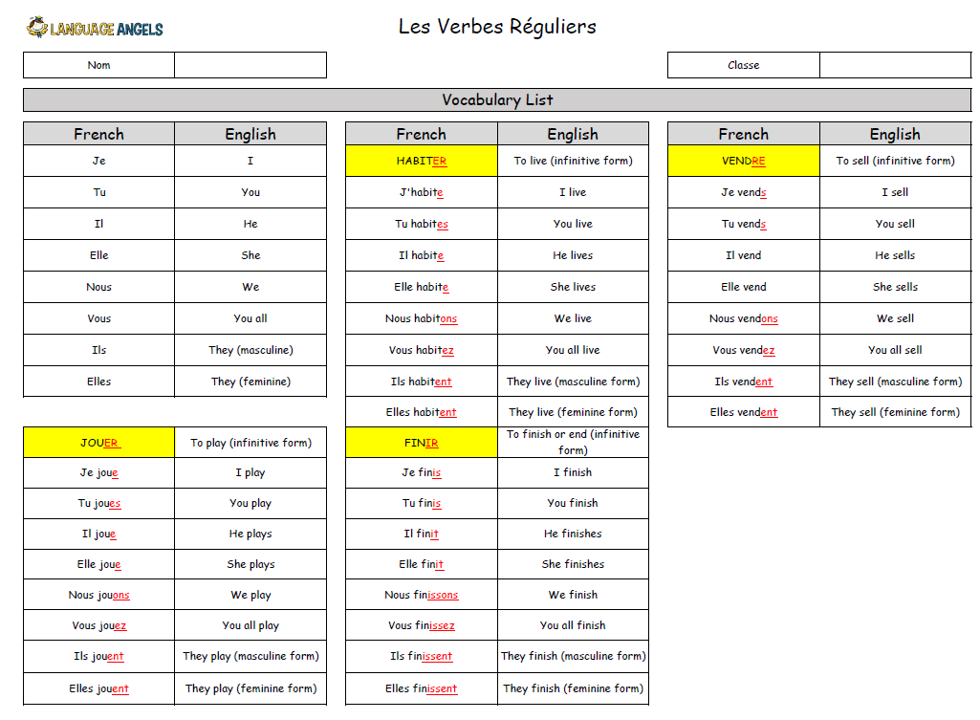
Y6 Autumn 2

Slide 25
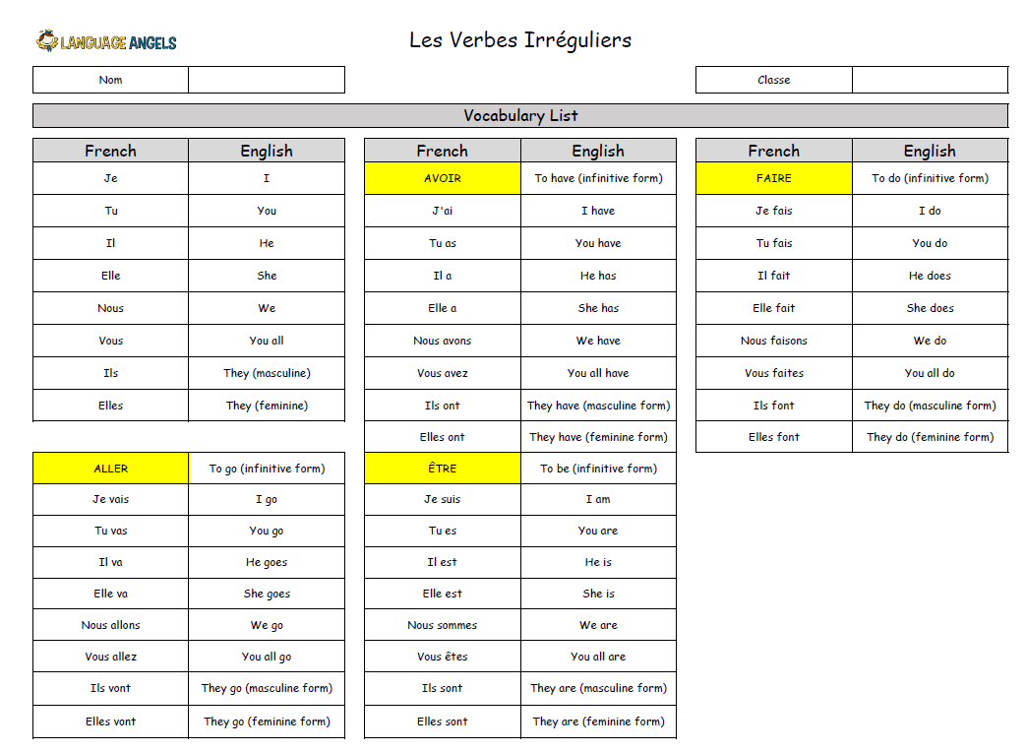
Y6 Spring 1

Slide 26
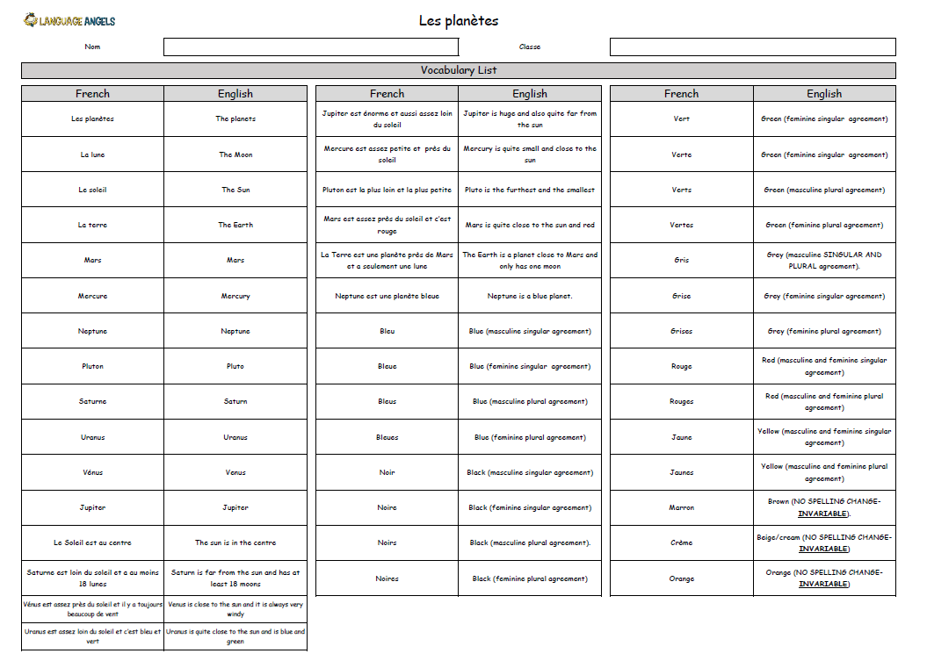
Y6 Spring 2

Slide 27
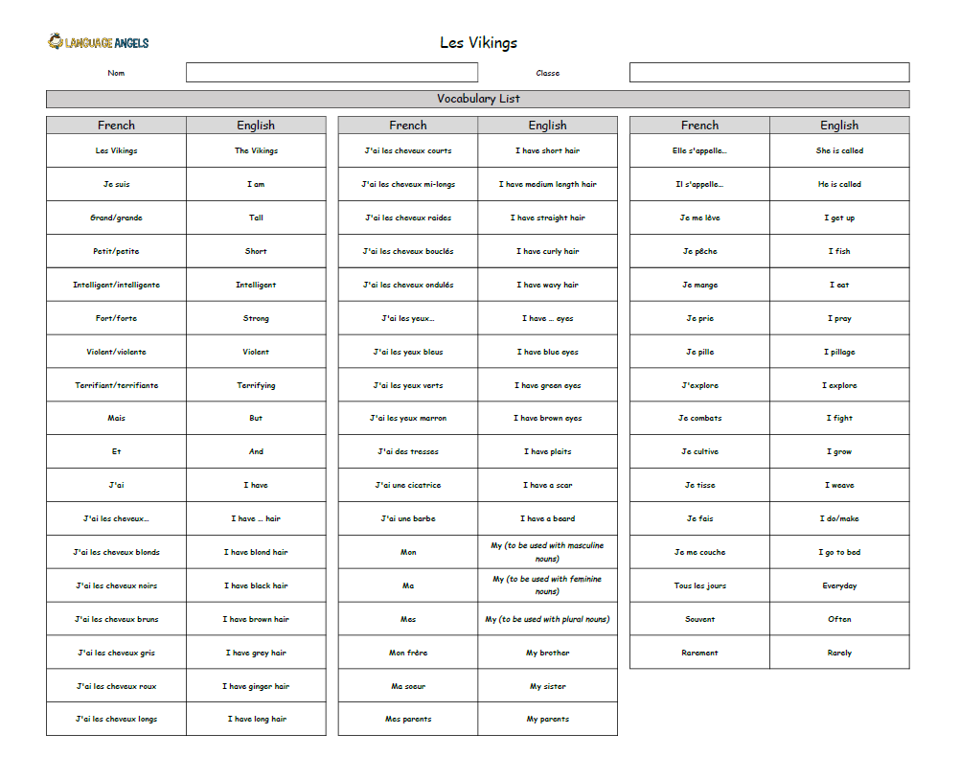
Y6 Summer 1

Slide 28
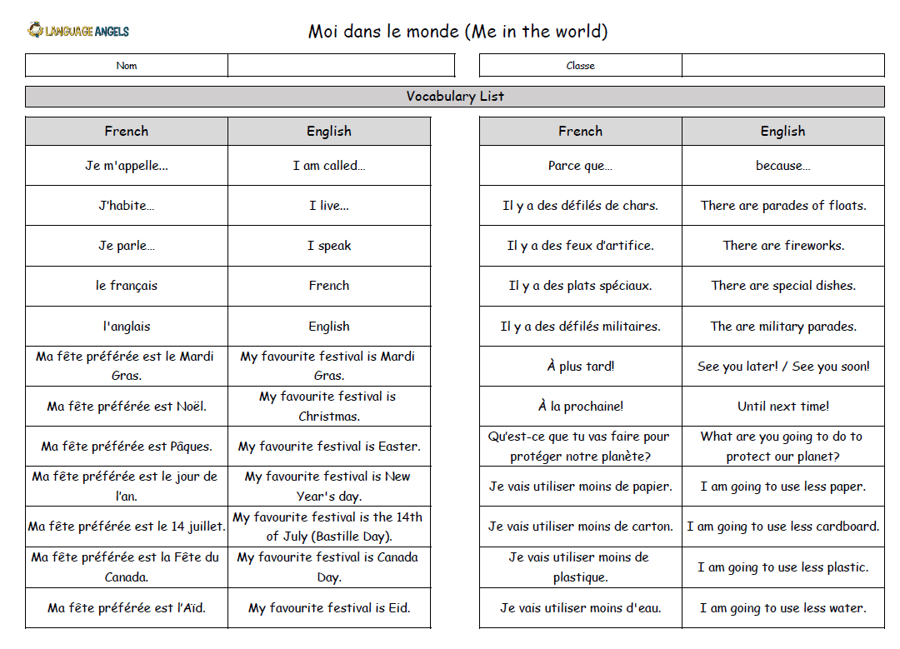
Y6 Summer 2

