Slide 1
Home Learning Summer Term Week 1 Lesson 5
Adventure Story
Retell the story from the perspective of Tony’s teddy bear.

Slide 2
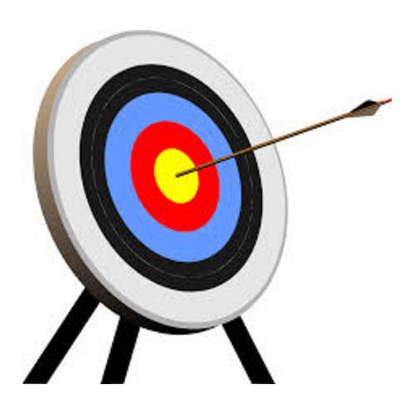
Tasks
Today we will:
Publish your work
Use your neatest handwriting to publish your work
You could even type your work up
Illustrate (draw a picture) your work

Slide 3
Success Criteria
Y3 | Sometimes (I am beginning to independently use)
1 | I can develop a writing stamina and produce extended pieces of writing
2 | In narratives, I can describe settings
3 | In narratives, I can describe characters and plot
4 | In non-narratives, I can use headings and subheadings
5 | I can begin using paragraphs to organise ideas
6 | I can use capital letters correctly for proper nouns and at the start of sentences
7 | I can use full stops correctly at the end of sentences
8 | I can use commas correctly for lists
9 | I can use a subordinate clause
10 | I can use a or an correctly
11 | I can use co-ordinating conjunctions
12 | I can use subordinating conjunctions
13 | I can use adverbs
14 | I can begin using inverted commas to punctuate direct speech
15 | I can use tenses correctly
16 | I can use prepositions to express place and time
17 | I can spell many words with the correct prefixes and suffixes
18 | I can spell some words correctly, (including those from the Year 3 / Year 4 list)
19 | I can write legibly using my best handwriting
20 | I can make deliberate ambitious word choices

Slide 4
Task
Publish your work
Use your neatest handwriting to publish your work
You could even type your work up
Illustrate (draw a picture) your work

