Slide 2
Aim
To record and interpret data on the effects of penicillin using a scatter graph.
Success Criteria
I can describe Fleming’s discovery of penicillin.
I can construct a scatter graph from a table of results.
I can answer questions about the effects of penicillin using my scatter graph.

Slide 3
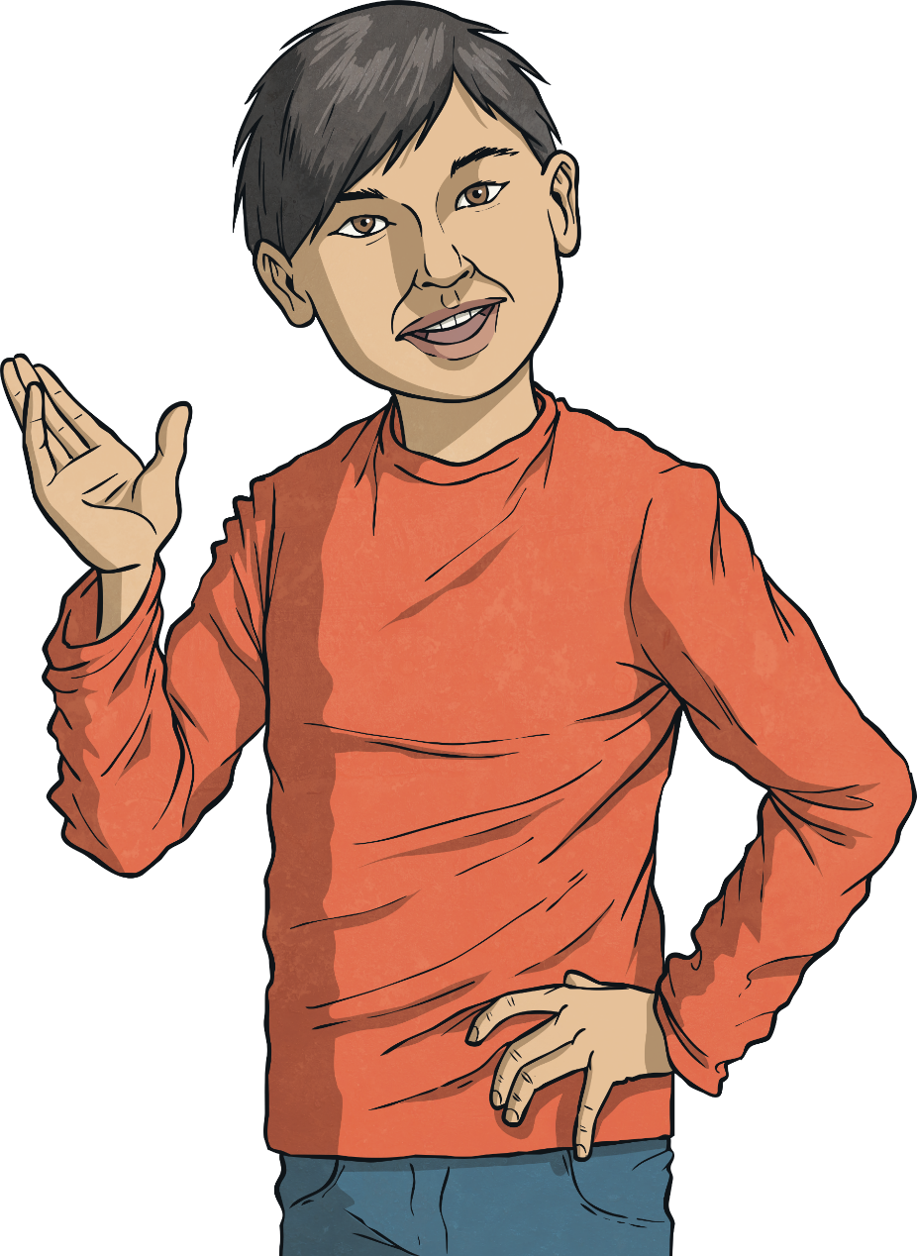
Treating Illnesses
Some illnesses are caused by microorganisms. Which of the conditions below are caused by microorganisms such as bacteria, fungi or viruses?
See next slide for answers
Chicken pox
Chicken pox
Nose bleed
Ear infection
Ear infection
Impetigo
Impetigo
Broken leg
Tonsillitis
Tonsillitis
Athlete's foot
Athlete's foot
Salmonella
Salmonella

Slide 4
Answers
Some illnesses are caused by microorganisms. Which of the conditions below are caused by microorganisms such as bacteria, fungi or viruses?
Green = caused by a microorganism
Purple = not caused by a microorganism
Chicken pox
Nose bleed
Ear infection
Impetigo
Broken leg
Tonsillitis
Athlete's foot
Salmonella

Slide 5
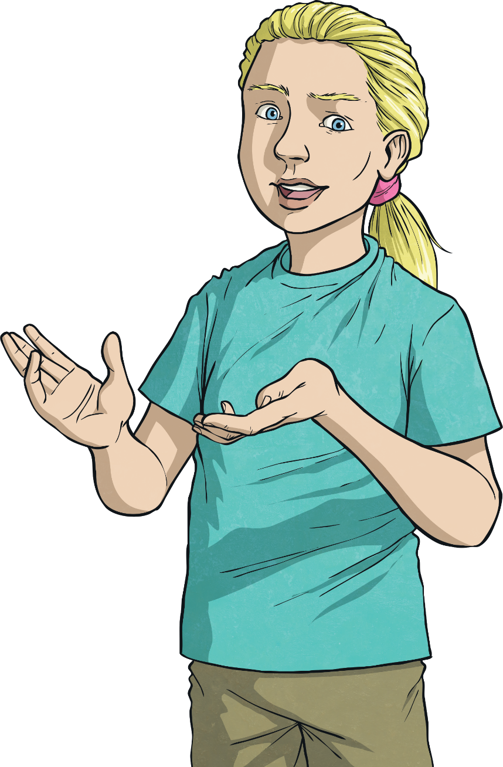
Treating Illnesses
There are different ways to treat illnesses caused by microorganisms. Some of the medicines kill or stop the growth of the bacteria or fungus that caused the illness, whereas other medicines just ease the symptoms of the illness.
Which of the medicines below do you think will kill or stop the growth of microorganisms and which will treat the illnesses caused?
Paracetamol
Antiseptics
Antiseptics
Antibiotics
Antibiotics
Cough medicine

Slide 6
Treating Illnesses
Which of the medicines below do you think will kill or stop the growth of microorganisms and which will treat the illnesses caused?
Treat the illness caused by microorganisms:
Paracetamol
Cough medicine
Kill or stop the group of microorganisms:
Antibiotics
Antiseptics

Slide 7
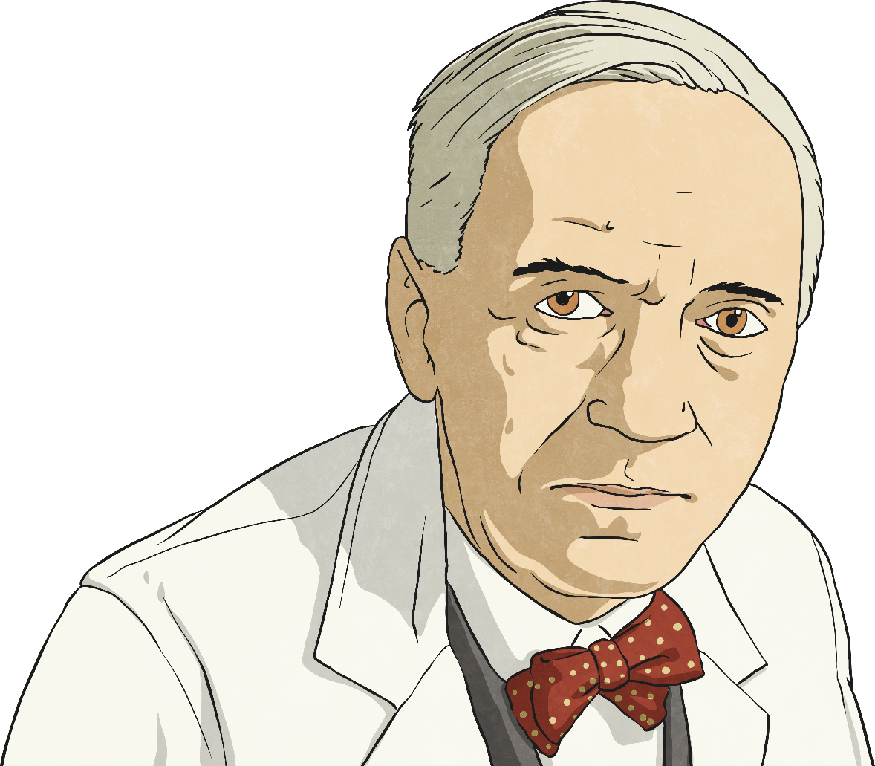
Alexander Fleming
Alexander Fleming was a Scottish scientist who made an important breakthrough in the treatment of illnesses caused by bacteria.
He was born in 1881 and grew up in his family home in Scotland.
At the age of 20, Fleming began a medical degree at St Mary’s Hospital Medical School in Paddington, London. Fleming’s brother Tom was also a doctor.

Slide 8
Alexander Fleming
During the First World War, Fleming served as a captain in the Royal Army Medical Corps. He worked in battlefield hospitals on the Western Front in France throughout the war. Fleming witnessed the deaths of many soldiers from infected wounds.
After the war, his experiences led him to begin investigations to find an antibacterial medicine that could treat infections.

Slide 9
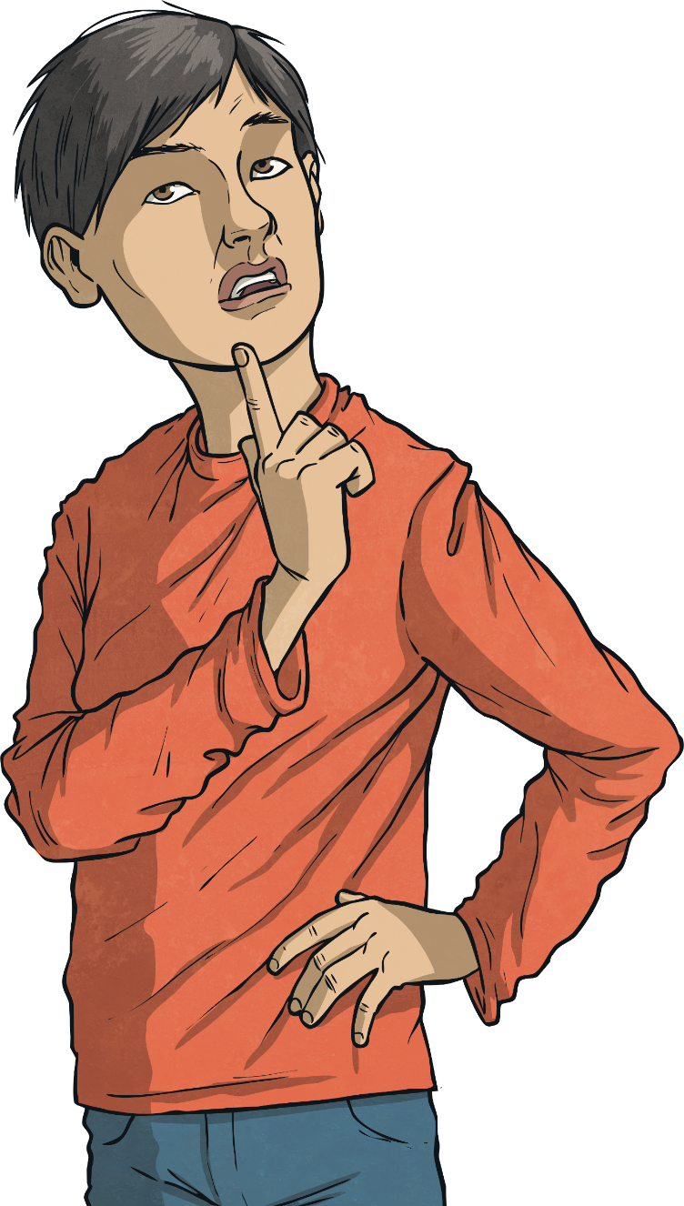
Fleming's Discovery
By 1928, Fleming had been investigating bacteria and antibacterials for several years. He had made some important discoveries, such as the discovery of lysozyme, an enzyme (chemical) in the human body that fights bacteria.
Unfortunately, though his name had become well known, he had not found anything that could be used to fight bacteria on a large scale.
This all changed in September 1928.
Listen carefully to the story of his discovery and think about what you feel is the most important moment.

Slide 10
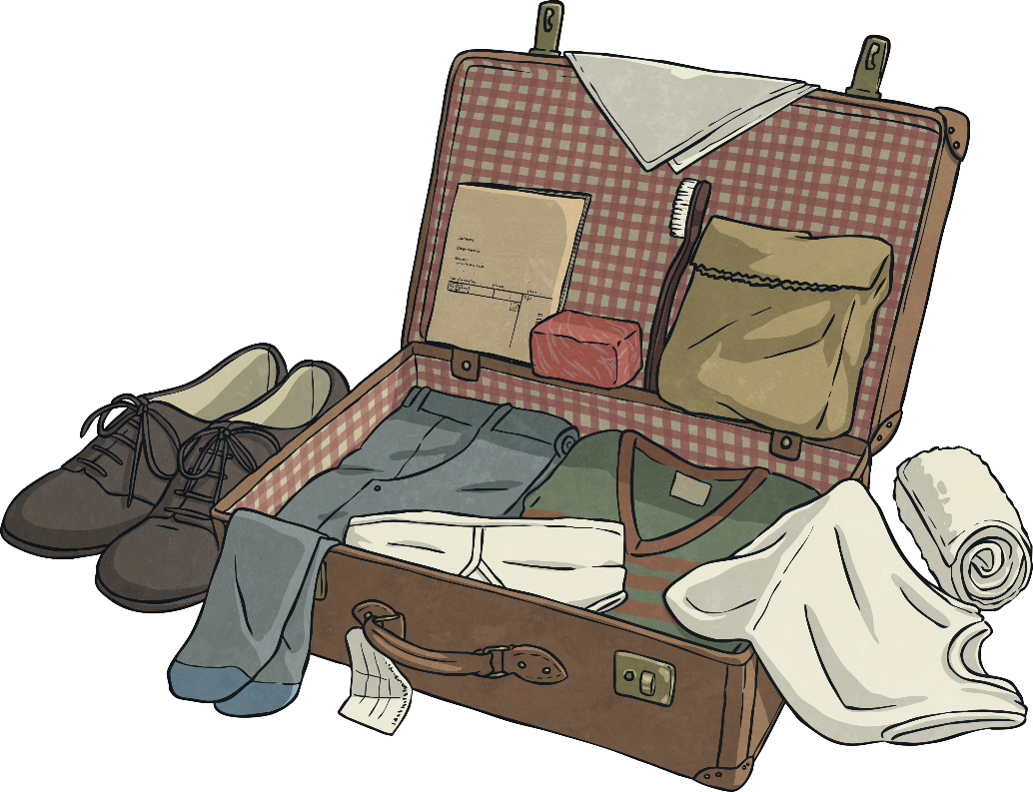
Fleming's Discovery
Fleming had been on holiday with his family for the whole of August. He was a brilliant scientist, but was known to be very untidy. He had not cleaned up his recent experiments with bacteria when he left for his holiday.
When he arrived back, he went to his lab to sort through his old investigations. He began to tidy up some Petri dishes in which he had been growing bacteria.

Slide 11
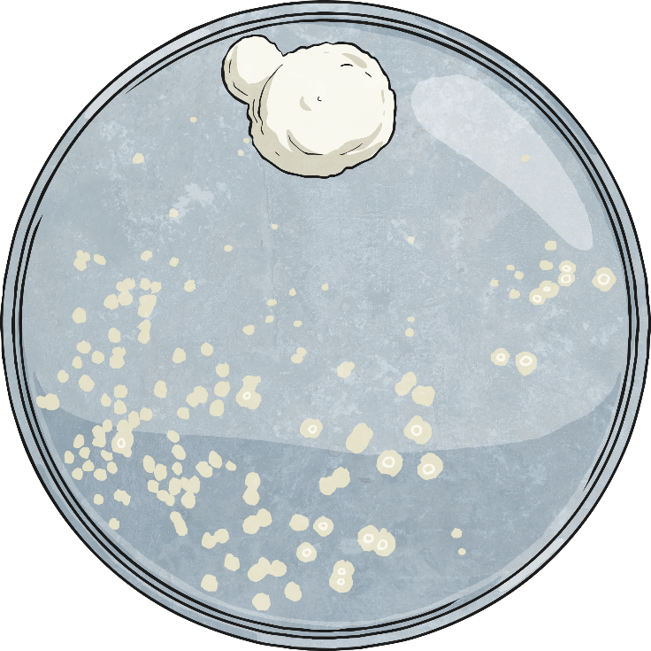
Fleming's Discovery
He noticed that mould had grown in one of the Petri dishes. The colonies of bacteria around the mould had been destroyed, whereas the bacteria in other Petri dishes were still alive.
Fleming showed his discovery to his assistant, who agreed that it was unusual.

Slide 12
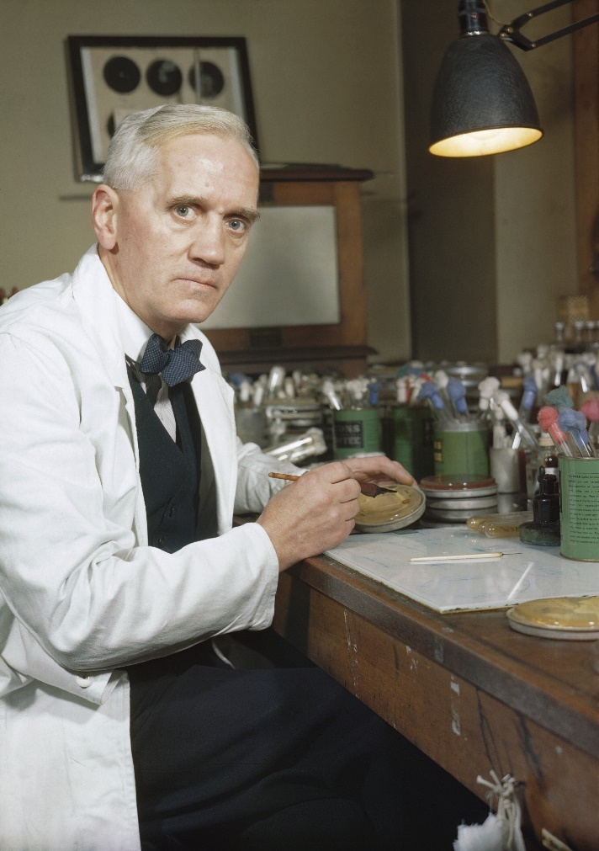
Fleming's Discovery
Fleming grew the mould in another Petri dish and found that it killed several types of disease-causing bacteria.
He originally called his discovery 'mould juice', but in March 1929 he officially named the substance ‘penicillin’.
Fleming had discovered the world's first antibiotic that could be used to treat illnesses caused by bacteria.

Slide 13
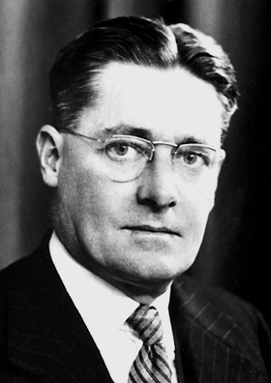
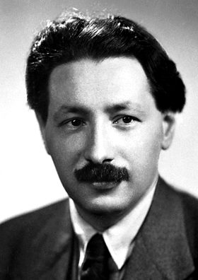
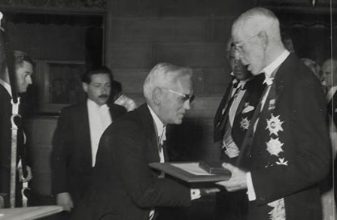
Fleming's Discovery
Two other scientists called Howard Florey and Ernst Boris Chain then built on Fleming's discovery to mass-produce penicillin in order to treat the wounded soldiers of the Second World War.
Fleming, Florey and Chain were awarded the Nobel Prize for their work in 1945.

Slide 14
Your Task - Part 1
Construct a scatter graph using the information on the ‘Penicillin Effects’ worksheet as a template. Once you have constructed your graph, answer the questions about the effects of penicillin on bacteria.

Slide 15
Your Task – Part 2
Once you have constructed your graph, answer the questions about the effects of penicillin on bacteria.

Slide 16
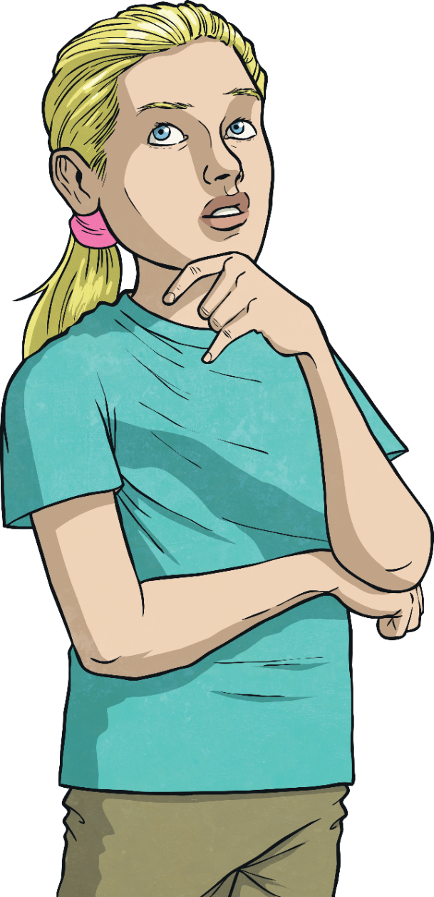
Final Thought - Antibiotic Resistance
Penicillin has been used to treat illnesses caused by bacteria ever since Alexander Fleming first discovered it.
However, some types of bacteria can become resistant to antibiotics like penicillin. This means the antibiotics no longer affect them.
What are the potential implications of antibiotic resistance?
What do scientists need to do to prepare for increased antibiotic resistance?

