Slide 2
Aim
To explain how diet affects the way the body functions.
Success Criteria
I can identify the positive and negative effects that different foods have on my body.
I can identify where my food comes from.
I can explain how cholesterol affects the body.

Slide 3
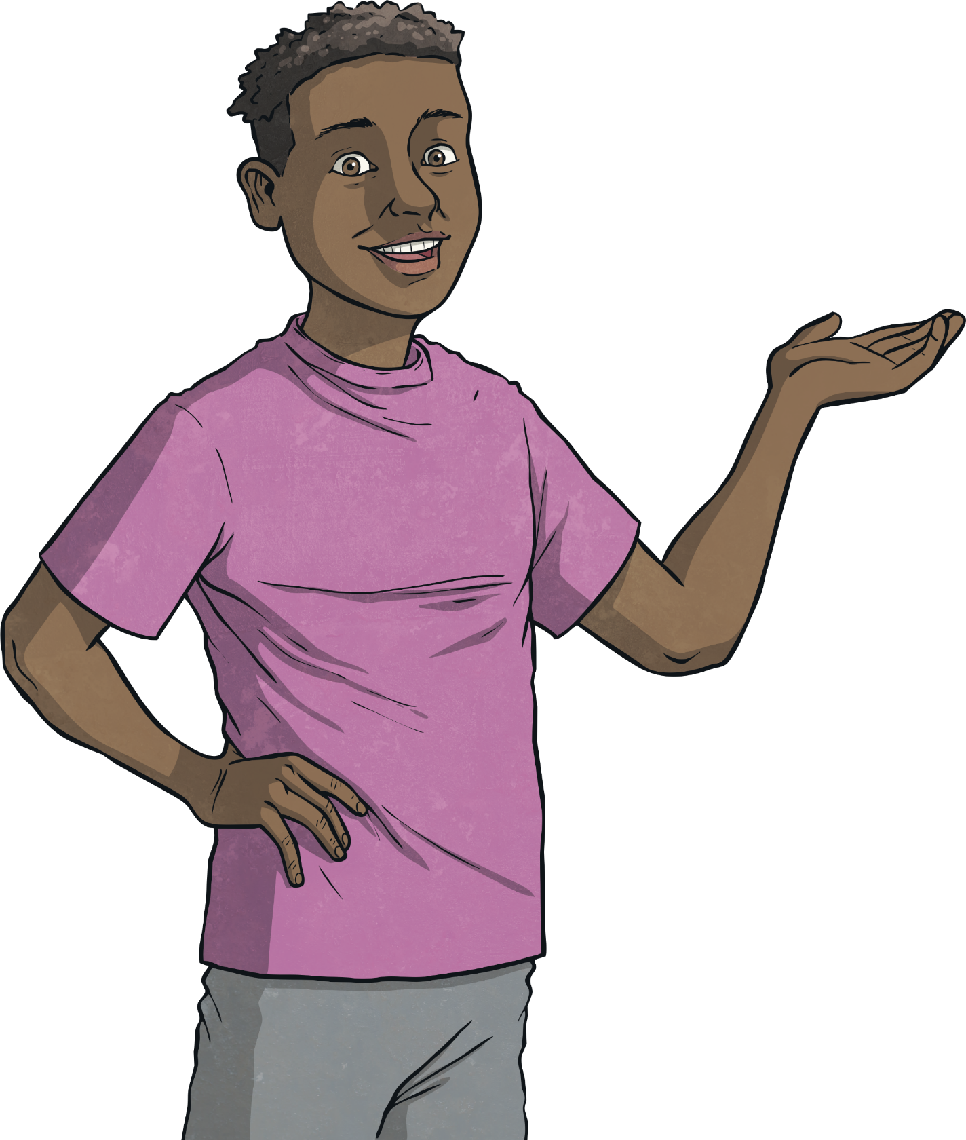
Keeping Healthy
What do you do to stay healthy?
Make a list.

Slide 4
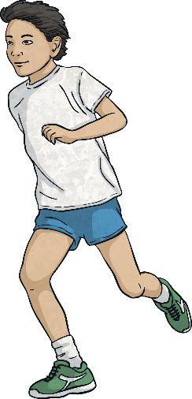
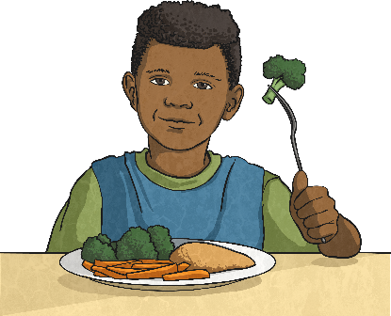
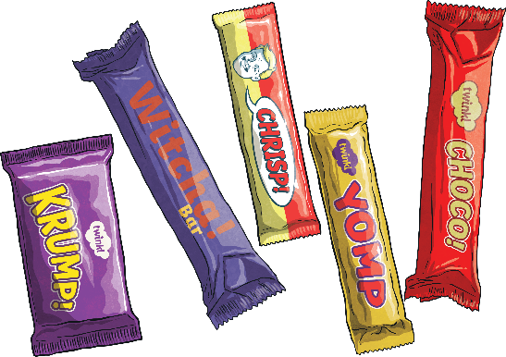
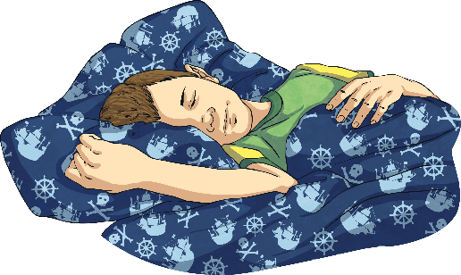
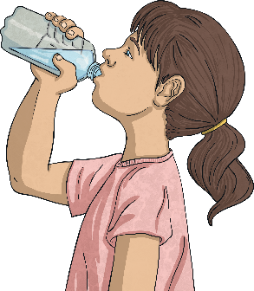
Keeping Healthy
Did you get all of these? Any others?
Eat healthily
Exercise
Avoid too much ‘junk’ food.
Sleep enough
Drink plenty

Slide 5
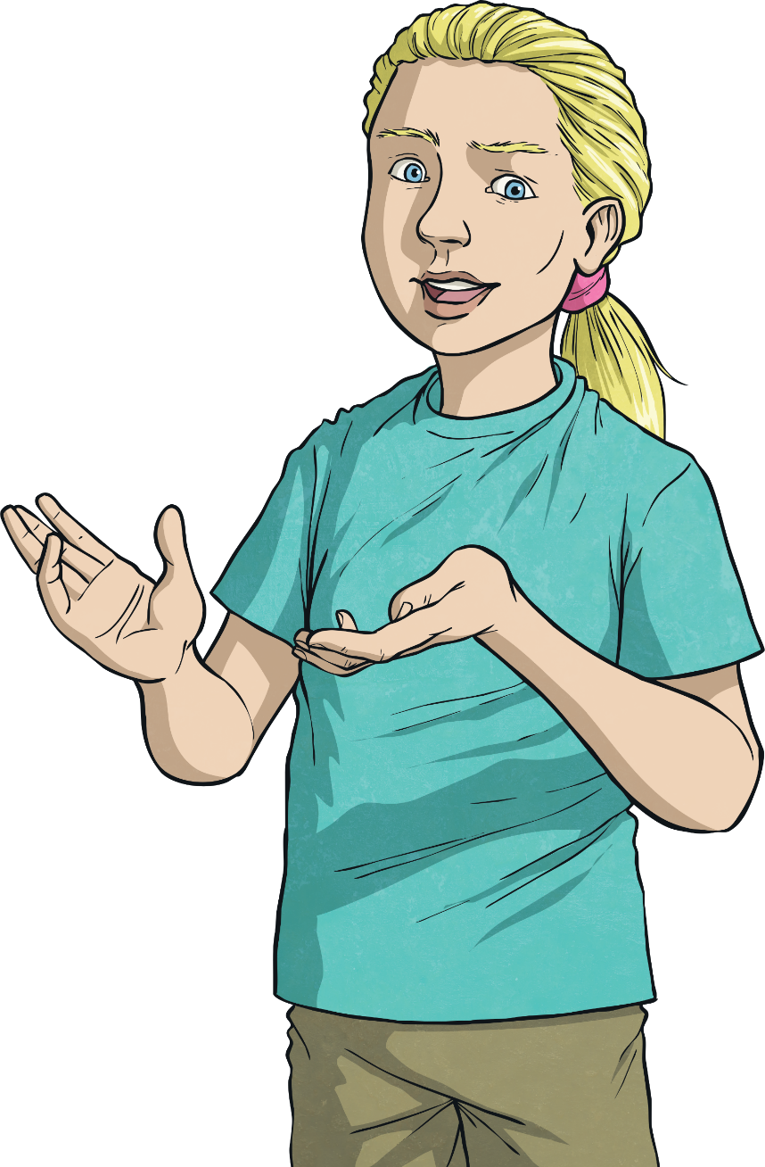
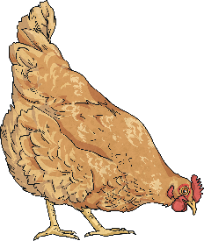
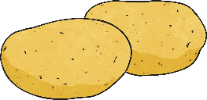
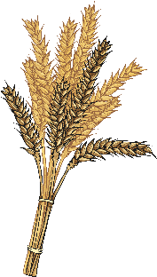
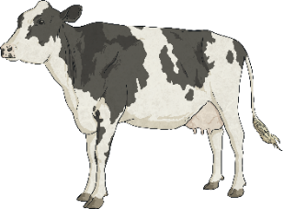
Food Sources
Today we are going to focus on how food keeps us healthy.
First, we’re going to think about where our food comes from.
Look at these food sources and write down all the foods that humans can get from each one.
Chicken
Potato
Wheat
Cow

Slide 6
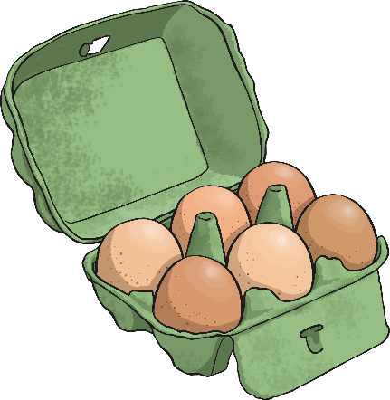
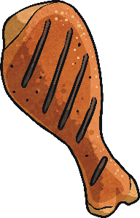
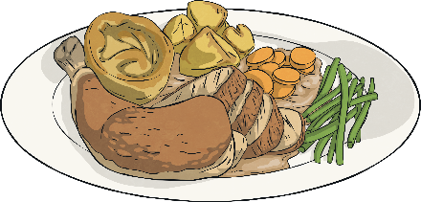
Did you think of any others?
Food Sources
eggs
chicken
chicken drumsticks
roast chicken
chicken nuggets

Slide 7
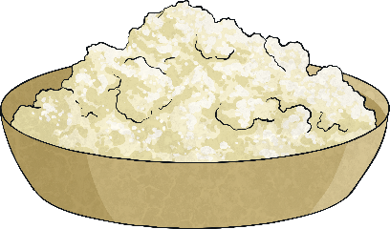
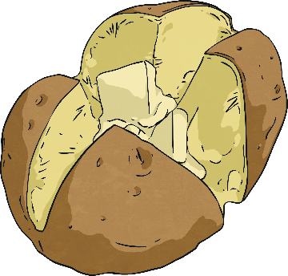
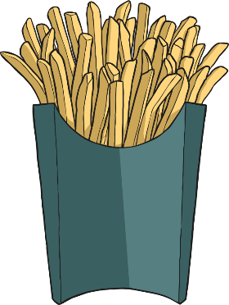
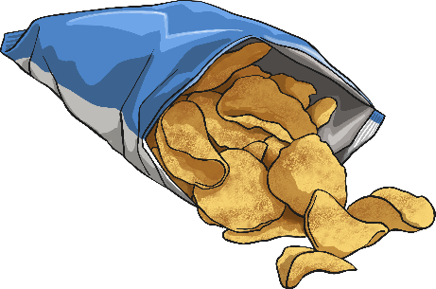
Did you think of any others?
Food Sources
roast potatoes
mash
jacket potatoes
potato
chips
crisps

Slide 8
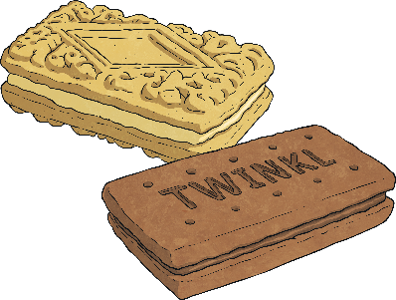
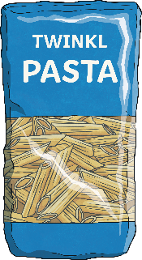
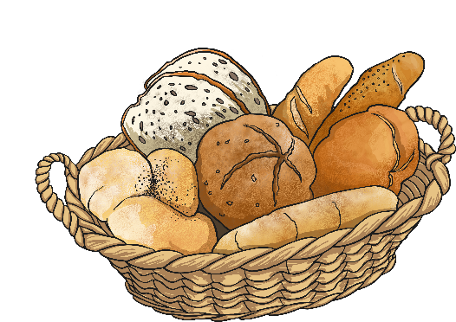
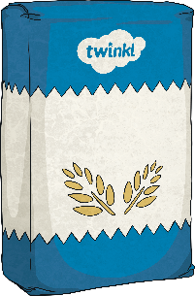
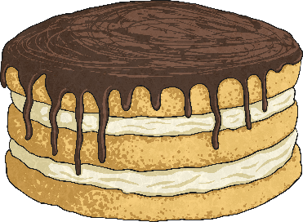
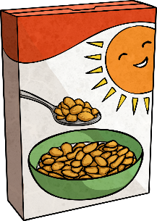
Did you think of any others?
Food Sources
pasta
biscuits
bread
wheat
cakes
flour
breakfast cereal

Slide 9
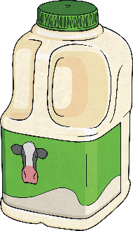
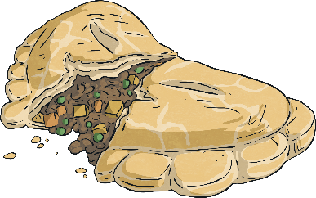
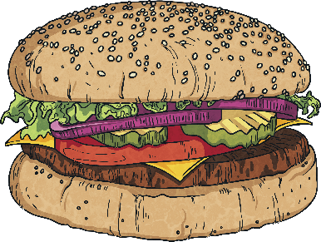
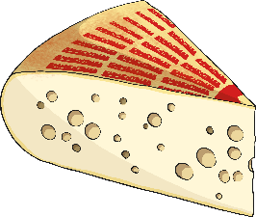
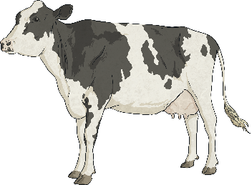
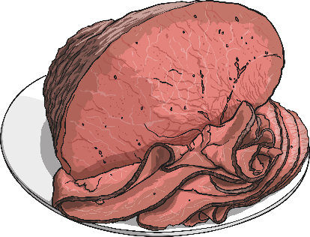
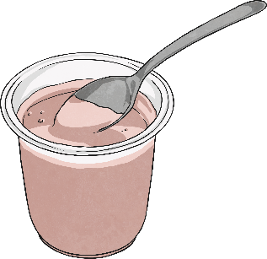
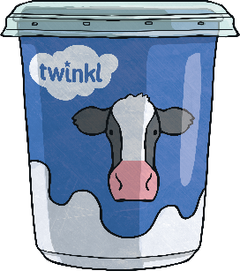
Did you think of any others?
Food Sources
mince
milk
burger
cow
cheese
beef
yoghurt
cream

Slide 10
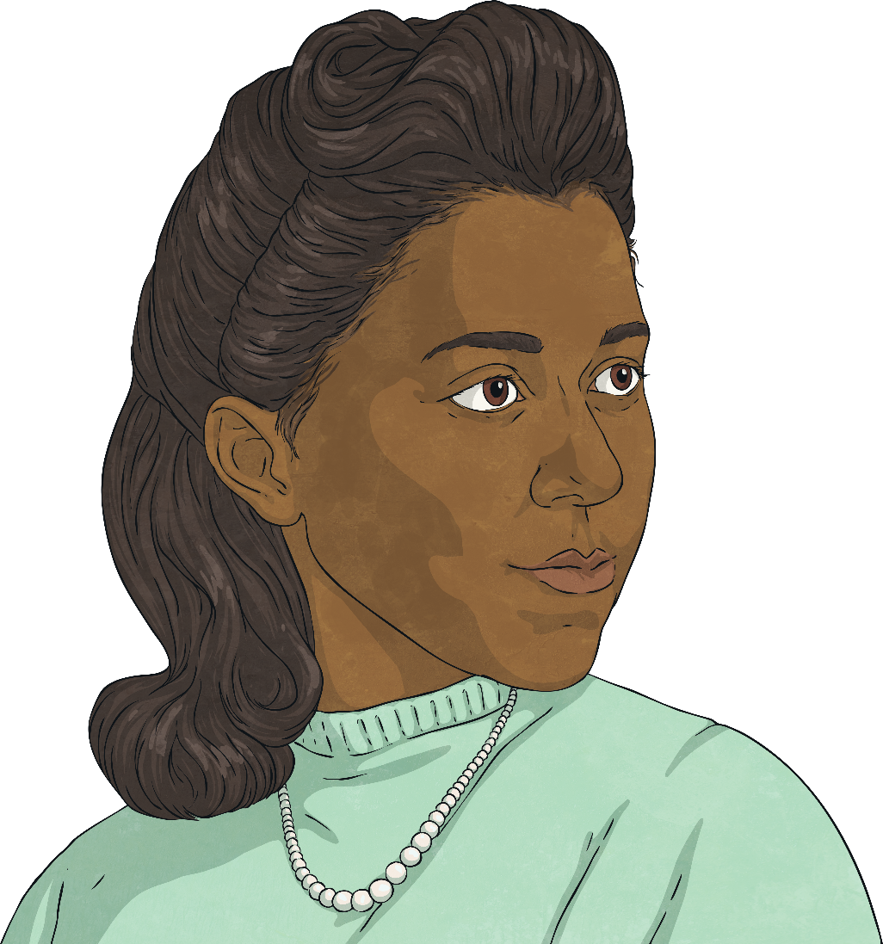
Marie Maynard Daly
Someone who researched the effects of foods on the body was Marie Maynard Daly.
Marie Maynard Daly studied chemistry in New York, after attending an all-girls school that supported her interest in science.
She graduated with a degree from Queens University in 1942. She then took just one more year to get a master’s degree while working as a lab assistant.

Slide 11
Marie Maynard Daly
Daly tutored students for a year before pursuing a PhD at Columbia under the direction of Dr Mary L. Caldwell, who was studying digestion in the human body. Marie also chose to study the chemicals affecting human digestion.
Marie Maynard Daly became the first black woman with a PhD in chemistry in the USA.

Slide 12
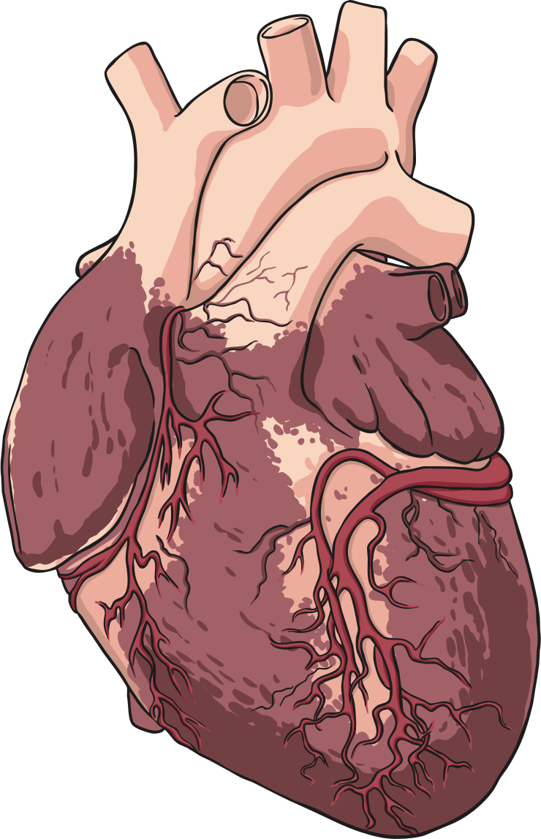
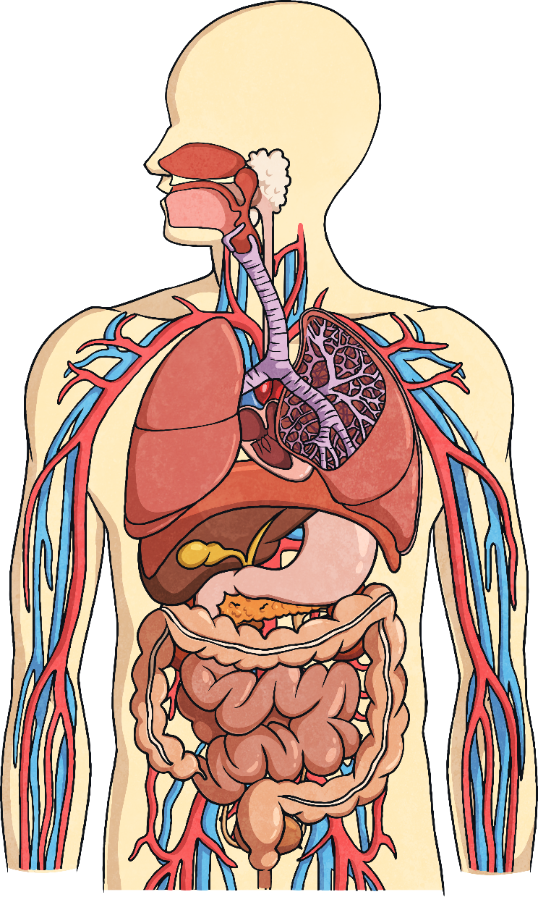
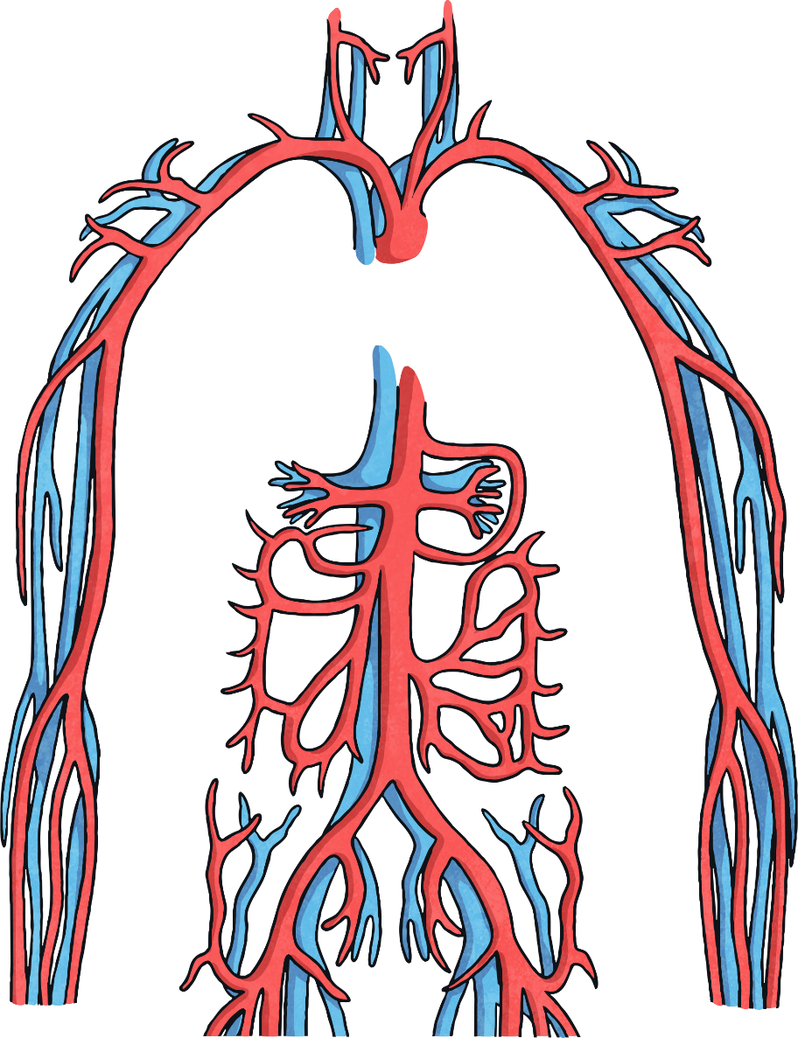
Marie Maynard Daly
Now a doctor, Marie continued to study the chemistry of the human body.
She made huge advances in our understanding of how the heart and circulatory system are affected by sugar and cholesterol in our diets.
Her work has demonstrated that too many fatty and sugary foods can make the arteries narrower and can cause heart disease.

Slide 13
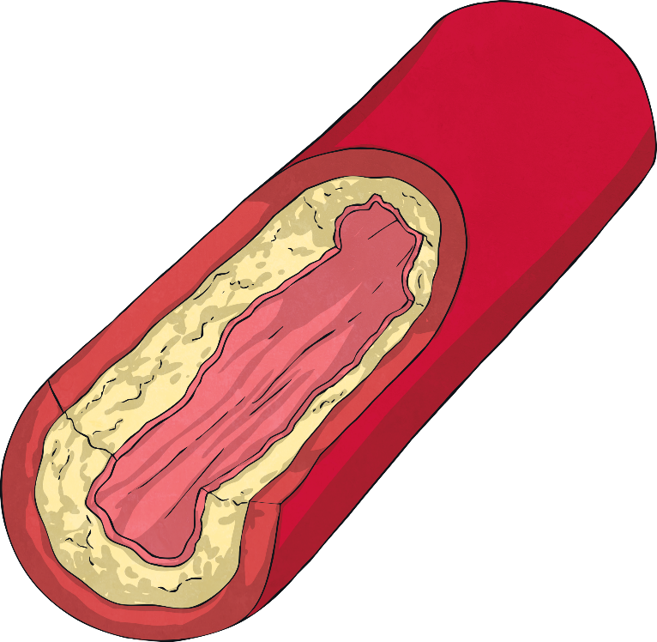
Cholesterol
Cholesterol is a type of fat that travels in the blood.
Our own livers actually make some cholesterol as some parts of our bodies need it.
We now know that there are two types of cholesterol.
One is good for keeping our blood vessels clean.
The other does the opposite - it can build up and block blood vessels which can be very dangerous. This was the type Marie Maynard Daly was interested in.

Slide 14
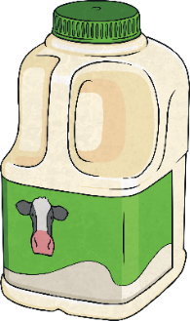
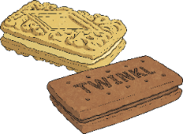
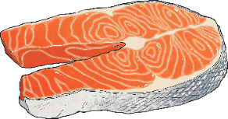
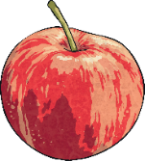
Cholesterol
Using the foods listed decide which you think has the most and least cholesterol. Rank them from highest to lowest.
Semi-skimmed milk
Salmon
Vegetable oil
Baked potatoes
Apples
Eggs
Chicken breast
Celery
Cheddar cheese
Which do you think has the highest cholesterol? Why?
Which do you think has the lowest cholesterol? Why?

Slide 15
Cholesterol
Here are the foods in order from lowest to highest amounts of cholesterol. They are shown here with the amount of cholesterol (in milligrams) per 100g.
How close was your list?
Food | Amount of cholesterol
apples | 0mg
vegetable oil | 0mg
baked potatoes | 0mg
celery | 0mg
semi-skimmed milk | 8mg
salmon | 55mg
chicken breast | 85mg
cheddar cheese | 105mg
eggs | 373mg
Did any surprise you?
What do you notice about the foods containing cholesterol?
They come from animal sources - in fact, cholesterol only comes from animal products.

Slide 16
Cholesterol
Remember, some cholesterol is good for you and that fatty foods can be enjoyed as an occasional treat as part of a healthy diet.
Food | Amount of cholesterol
apples | 0mg
vegetable oil | 0mg
baked potatoes | 0mg
celery | 0mg
semi-skimmed milk | 8mg
salmon | 55mg
chicken breast | 85mg
cheddar cheese | 105mg
eggs | 373mg
Food with high levels of cholesterol can often be good in other ways, including
as a source of protein e.g. eggs.

Slide 17
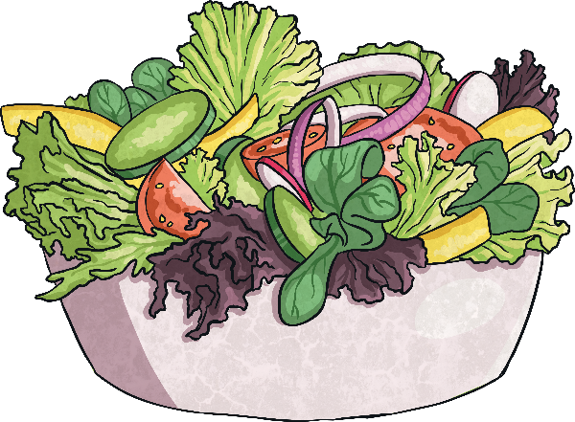
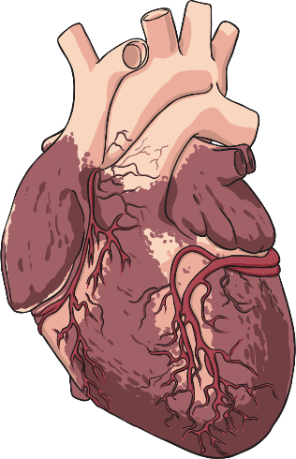
Cholesterol
Foods from plants contain no harmful cholesterol.
Health specialists advise people who need to lower their cholesterol levels to eat less meat and cheese. This should help them to keep their hearts healthy.
It was Marie Maynard Daly’s work which proved that too much cholesterol could narrow blood vessels and lead to serious heart problems.

Slide 18
Your Task - Diet and the Heart
Copy and complete this paragraph explaining how diet and cholesterol can effect the heart and circulation using what you have learnt today.

Slide 19
Your Task - Diet and the Heart
Copy and complete this diagram labelling the parts of an artery using what you have learnt today.

Slide 20
Answers - Diet and the Heart

Slide 21
Answers - Diet and the Heart

