Slide 1
Home Learning Summer Term Week 1 Lesson 3
Adventure Story
Retell the story from the perspective of Tony’s teddy bear.

Slide 2
Tasks
Today we will:
Confidently retell the story of Taking Flight from the perspective of Tony’s teddy bear.
Write the resolution section using features from the success criteria.
Watch the video to refresh your memory of the story.
https://www.literacyshed.com/takingflight.html

Slide 3
Success Criteria
Y3 | Sometimes (I am beginning to independently use)
1 | I can develop a writing stamina and produce extended pieces of writing
2 | In narratives, I can describe settings
3 | In narratives, I can describe characters and plot
4 | In non-narratives, I can use headings and subheadings
5 | I can begin using paragraphs to organise ideas
6 | I can use capital letters correctly for proper nouns and at the start of sentences
7 | I can use full stops correctly at the end of sentences
8 | I can use commas correctly for lists
9 | I can use a subordinate clause
10 | I can use a or an correctly
11 | I can use co-ordinating conjunctions
12 | I can use subordinating conjunctions
13 | I can use adverbs
14 | I can begin using inverted commas to punctuate direct speech
15 | I can use tenses correctly
16 | I can use prepositions to express place and time
17 | I can spell many words with the correct prefixes and suffixes
18 | I can spell some words correctly, (including those from the Year 3 / Year 4 list)
19 | I can write legibly using my best handwriting
20 | I can make deliberate ambitious word choices

Slide 4
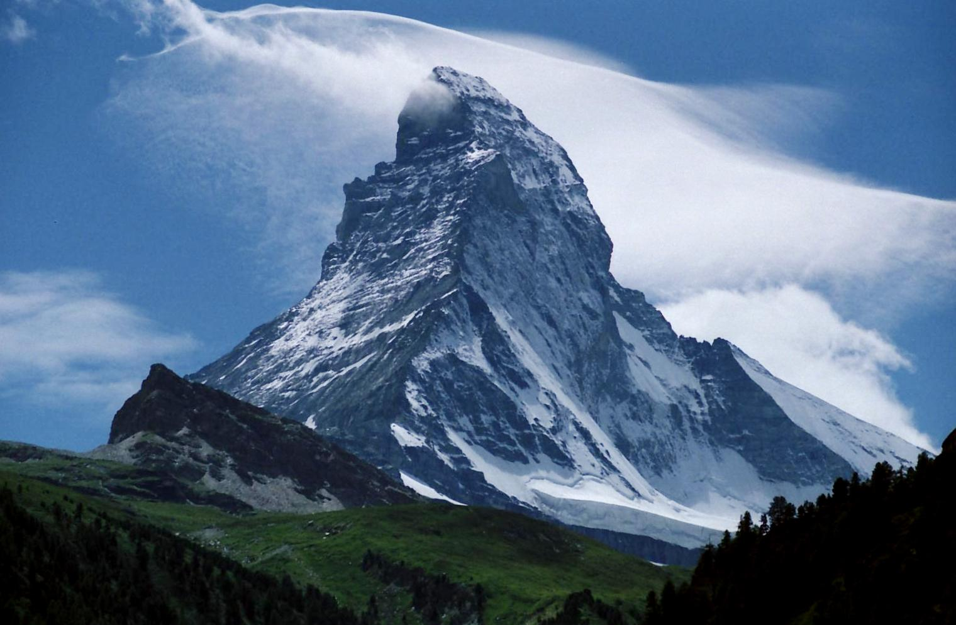
Problem
I watched Tony climb up onto the shelves to get the photograph. Things start to fall, including Tony and grandad rushes in.
Resolution
Grandad was angry to start with, he was worried about what Tony has done. Grandad then saw the wagon and told us to get in. We went on an adventure. We travelled across the jungle looking for scary monkeys before we ended up flying and fighting aliens.
Build Up
Grandad has to cut the grass so we sit on a box. We get fed up and lay down on the box. Tony spots something on the shelf.
Opening
Tony’s dad has to go to work so he dropped us off at grandad’s house.
Closing
Dad returned from work and was upset at the mess we were all in. Instead of being angry, he saw the wagon and remembered the fun he had as a child. We all went on one last adventure to the moon. I drove the rocket!

Slide 5
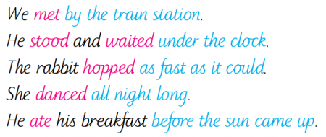
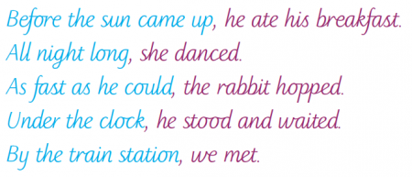
An adverbial is a word or phrase that has been used like an adverb to add detail or further information to a verb. (An easy way to remember what an adverb is: it adds to the verb.)
Adverbials are used to explain how, where or when something happened; they are like adverbs made up of more than one word.
For example: In the sentences above, the verbs are in pink and the adverbials are in blue.
'Fronted' adverbials are 'fronted' because they have been moved to the front of the sentence, before the verb. In other words, fronted adverbials are words or phrases at the beginning of a sentence, used to describe the action that follows.
A comma is normally used after an adverbial
For example: The fronted adverbials in these sentences are in blue.

Slide 6
Writing Your Own Fronted Adverbials: ISPACE
Use ISPACE to help you remember six different ways to create fronted adverbials...
I
-ing word
e.g. Shaking with fear, ...
S
Simile
e.g. Like a raging bull, ...
P
Preposition
e.g. Behind the clouds, ...
A
Adverb
e.g. Anxiously, ...
C
Conjunction
e.g. After he opened his eyes, ...
E
-ed word
e.g. Exhausted, ...

Slide 7
Setting description – use the 5 senses (sight, smell, touch, taste and hear)
When you write about a setting, you need to make sure you use lots of description so the reader can picture themselves there.
Effective descriptions appeal to the senses.
Capture brief snippets of characters- try to convey their mood in this description
Focus on the individuals, families or couples, who inhabit the scene
Try to include approximately 3-4 short character descriptions not just one long one
Try to use a variety of different senses
Zoom in on small, authentic details –
Show don’t tell (He was angry becomes As he clenched his fist he glared…)
Use interesting vocabulary- especially focus on the verb choices (He strolled…)
Create a sense of physical description by describing their facial expressions, posture, clothing etc

Slide 8
What Is an Expanded Noun Phrase?
Following the steps below, how could you expand this noun phrase?
A ship
Add a noun to modify
A pirate ship
Add adjectives to modify
An enormous, menacing pirate ship
Add a prepositional phrase to give extra details
An enormous, menacing pirate ship on the still, calm ocean

Slide 9
Task
Use your plan to write the resolution part of your story.
Try and use fronted adverbials, speech and commas for lists.
Remember….
Leave editing lines!

